Slide 1
EE333 Final Project
Customer Management System
Jonathan Myers - Data Model
Tyler Brasher - Graphical User Interface
Adam Ingah - Infrastructure
www.github.com/adamingah/EE333P5

Slide 2
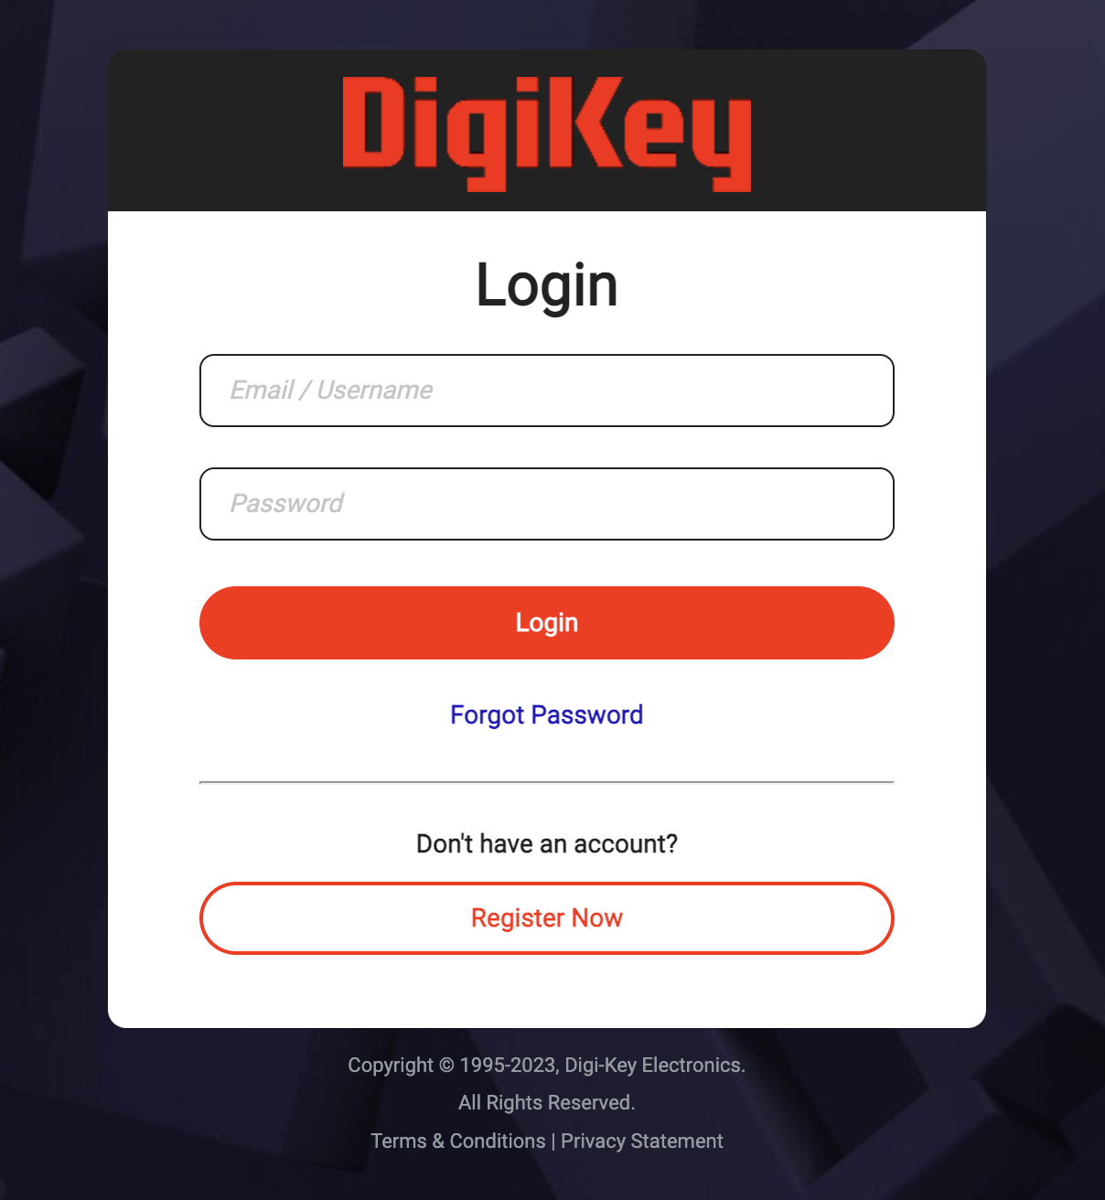
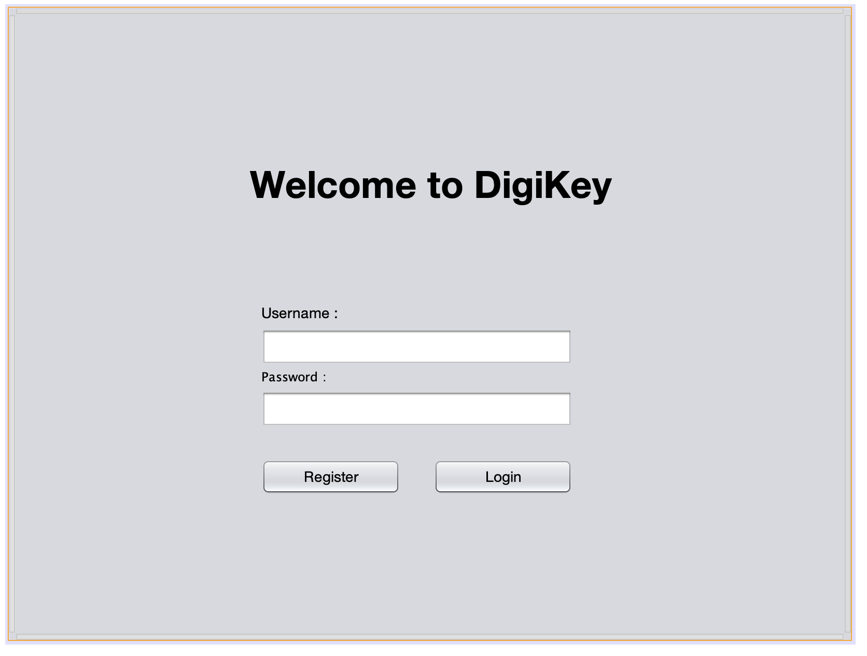
Project Description
The purpose of the project is to develop a customer management system that behaves like many e-commerce platforms. The platform we are specifically attempting to replicate is www.Digikey.com. From this platform, we wanted to be able to handle orders, customers, and internal users.

Slide 3
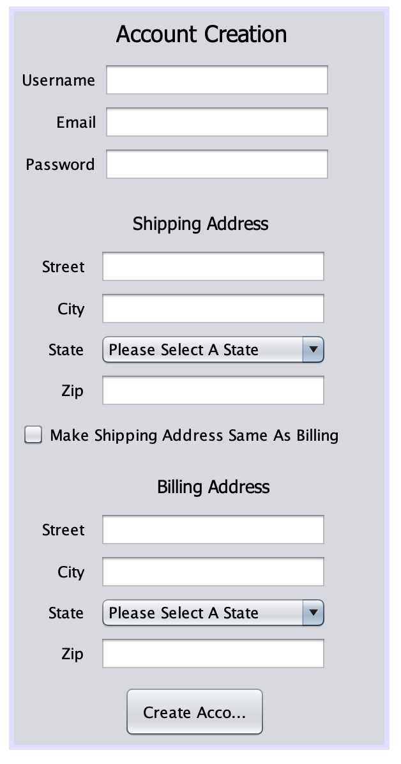
Functional Customer Requirements
Command line user interface AND Graphical User Interface
Create, read, update, archive, and delete a customer
Read, Update (quantity), and archive products
Create, read, update, archive (ship), and delete an order
Maintain customer and product information in a structured file
We used CSV format, and for the custom parser we used and regular expression.
Class Structure and inheritance for users and products
Using appropriate encapsulation techniques for User Data

Slide 4
Demonstration

Slide 5
Challenges and Improvements
/* To-do
* 1. Validation is an important part of file input/output, but with respect to time it was skipped.
* 2. Generating a random, unique ID for each user was a feature that was also cut due to time, but would have improved the functionality of the application
* 3. A wizard for setting up the type repository that data was stored in was something that was cut
* 4. Application/System testing was something we would’ve liked to do, but did not get to
* 5. Overall refinements (Styling, bugs, etc.)
*/

